Slide 1
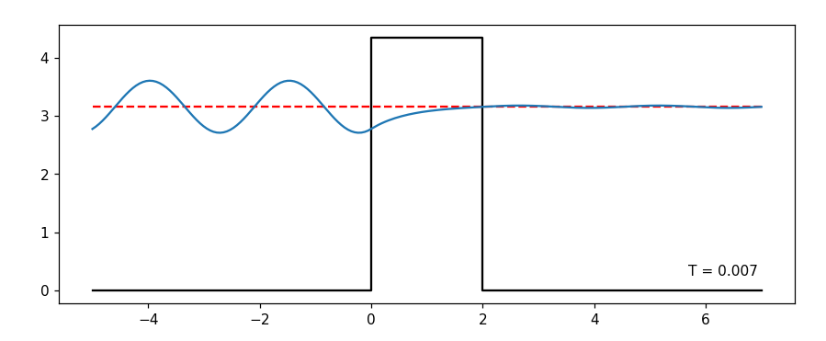
1.a) Single barrier
Exponentially decaying (as expected)

Slide 2
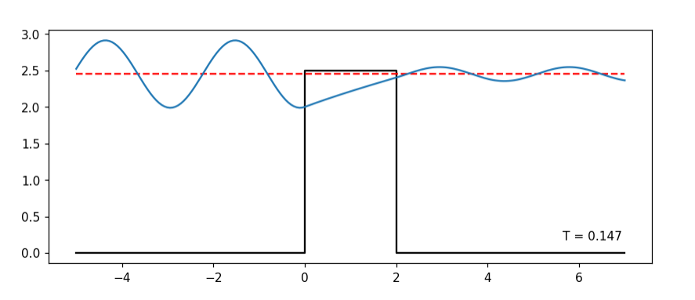
1.b) Energy: just below barrier height
Less decay than before.
After passing through barrier, it oscillates with the with the incoming frequency, but with a lower amplitude.

Slide 3
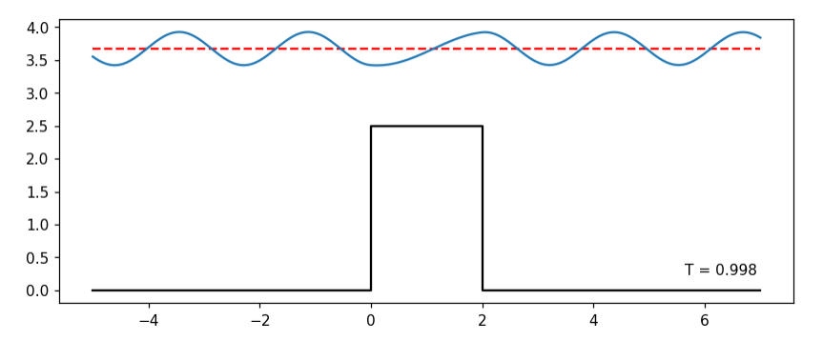
1.c) Just above the barrier
Frequency matches the incoming frequency.
Phase is “deformed”/”stretched” in the barrier region (between 0—2)
Amplitude seems largely unchanged.

Slide 4
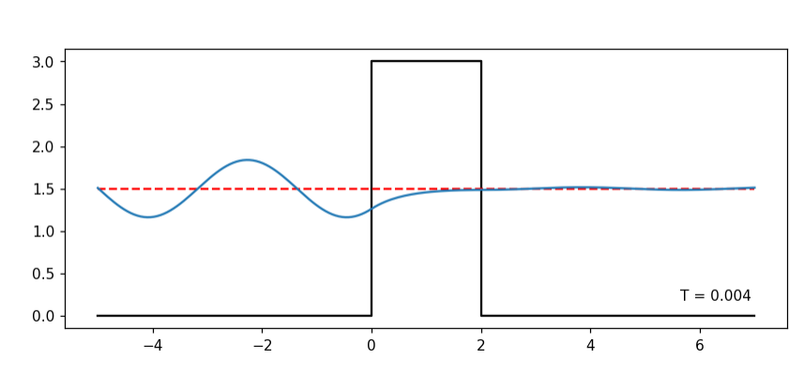
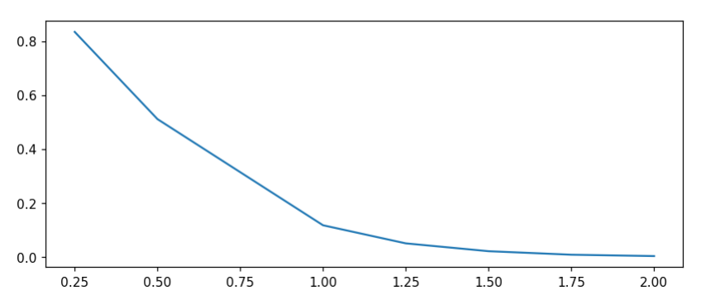
1.d) + 1.e) Energy half of barrier heigh
Thickness | Transmission (relative)
2 | 0.004
1.75 | 0.009
1.5 | 0.022
1.25 | 0.051
1 | 0.118
0.5 | 0.511
0.25 | 0.834
Exponential decaying

Slide 5
2

Slide 6
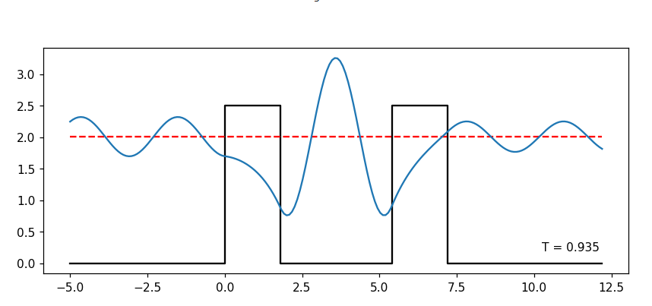
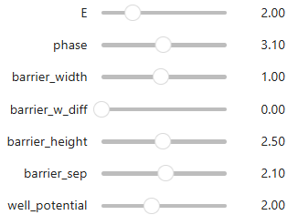
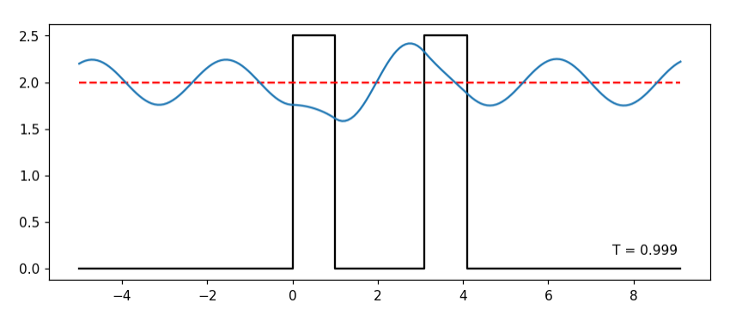
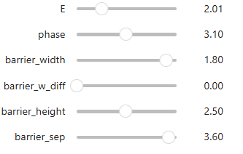
2.a) Two barrier (We changed multiple parameters)

Slide 7
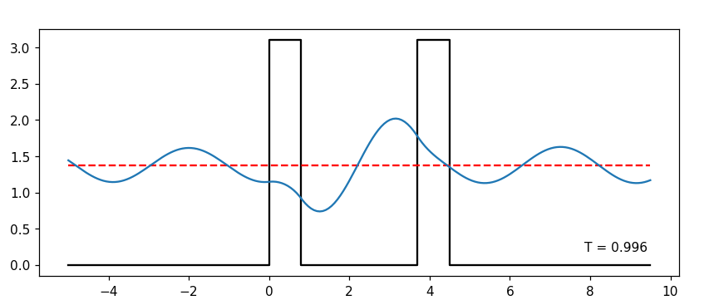
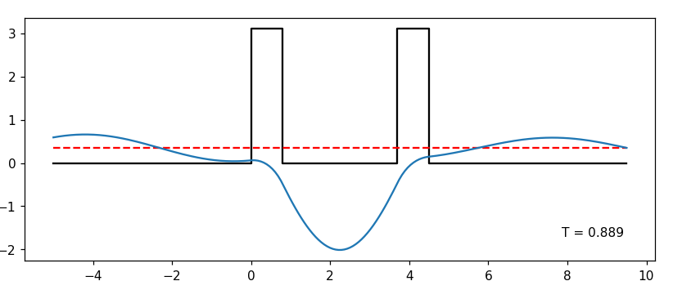
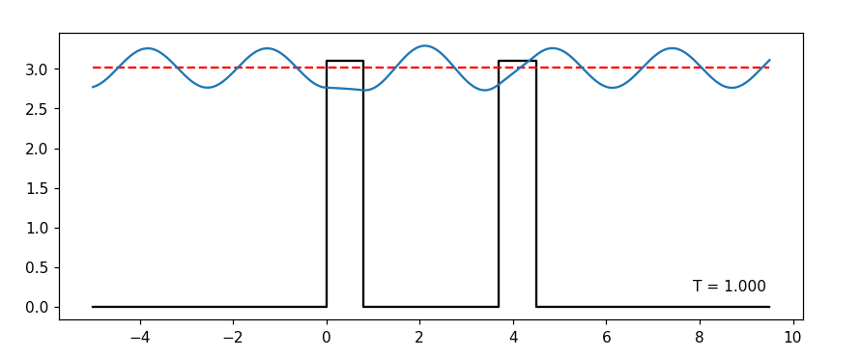
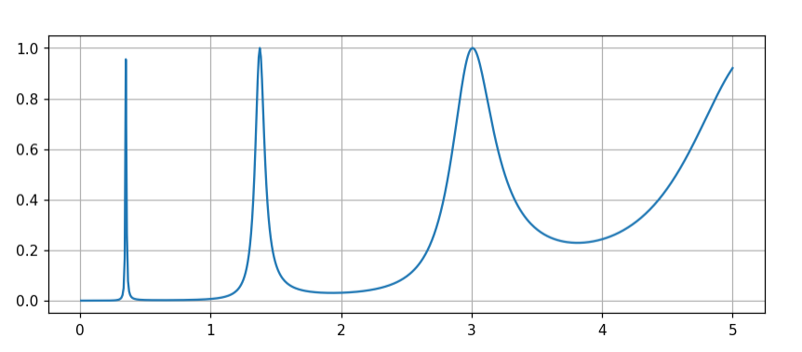
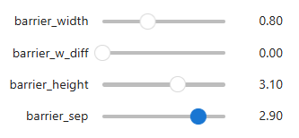
2.b) Same parameters different energy
Fano line-
shape?
E=0.35
E=1.38
E=3.01

Slide 8
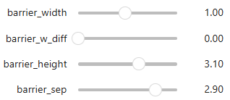
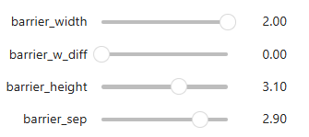
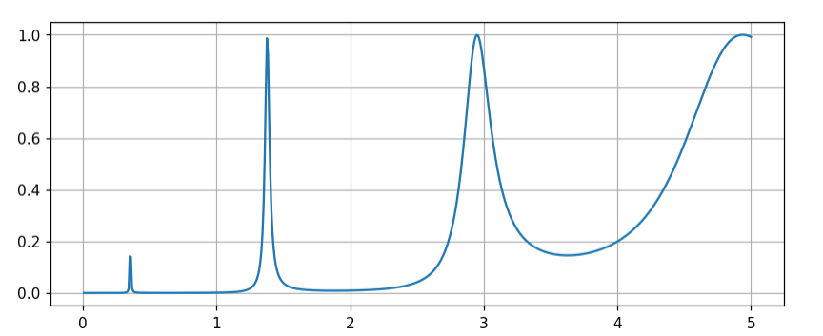
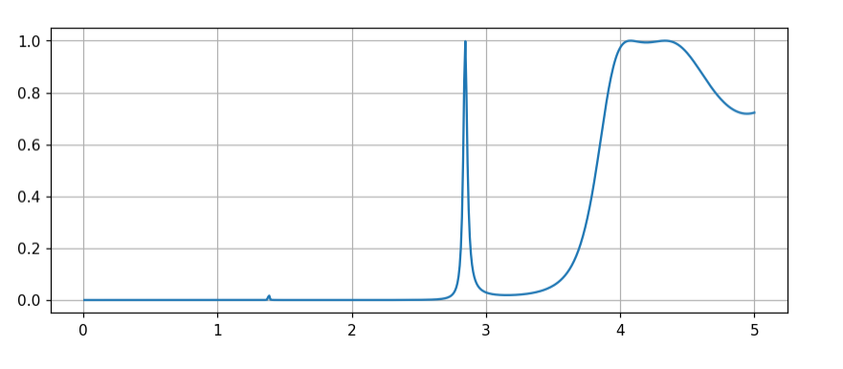
2.c) Adjusting barrier width:
The transmission of low resonant energies largely disappears.
Transmission of higher resonant energy peak becomes sharper.

Slide 9
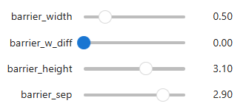
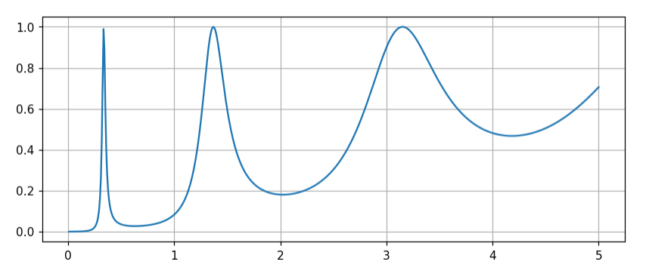
2.d) Comparing barrier width (lower)
The opposite of before – higher resonant energy peaks becomes less localized, as opposed to lower resonant energy peaks.

Slide 10
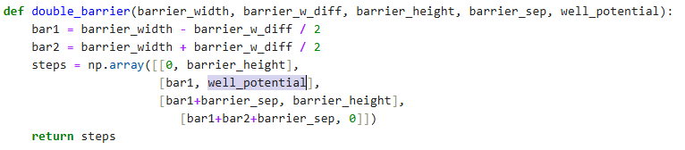
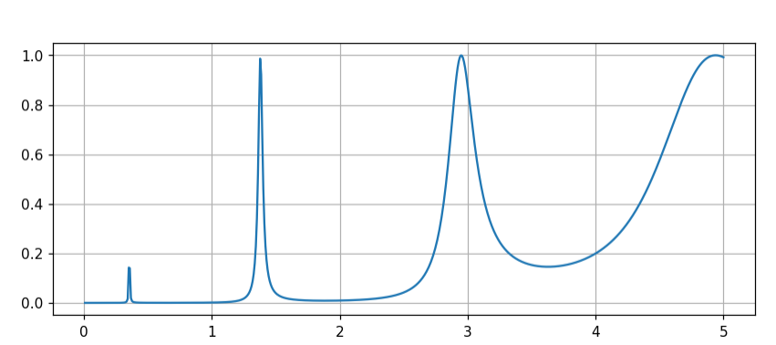
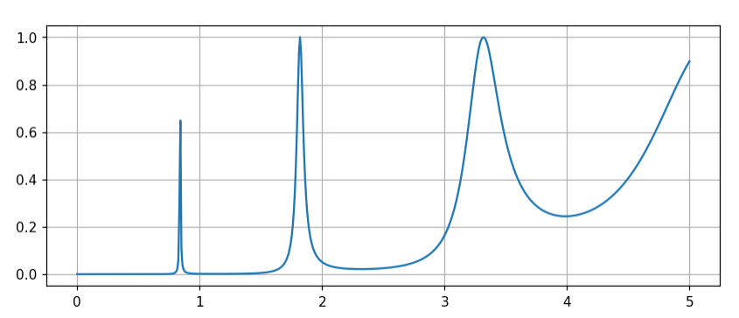
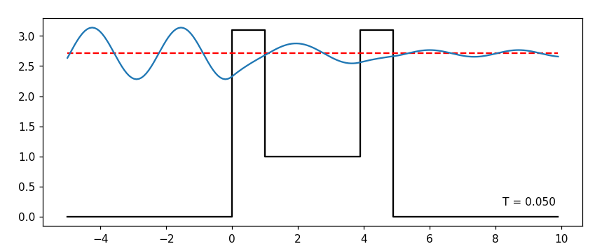
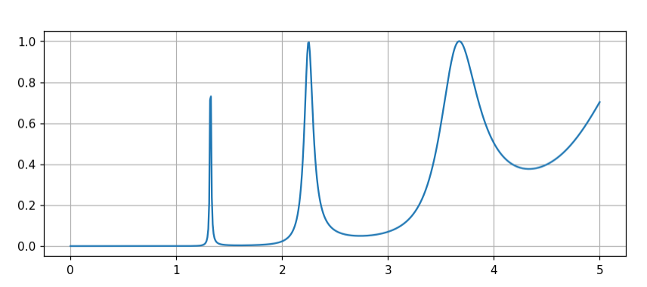
2.e)
Well-potential: 0 [eV]
Well-potential: 0.5 [eV]
Well-potential: 1.0 [eV]

Slide 11
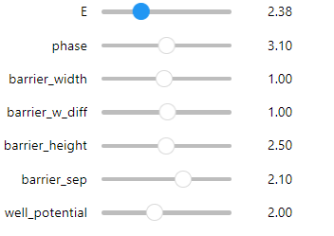
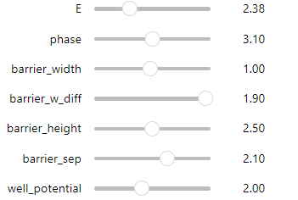
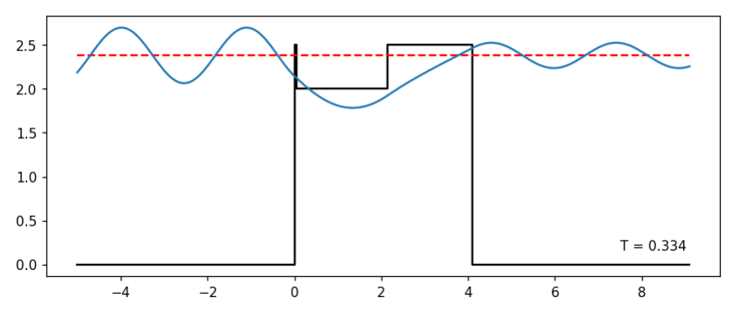
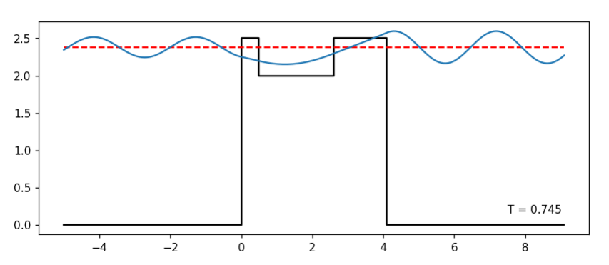
2.f)
Transmission decreases

Slide 12
3

Slide 13
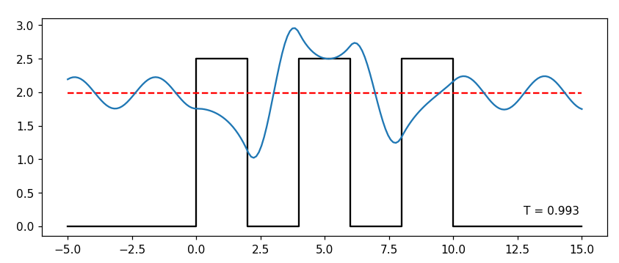
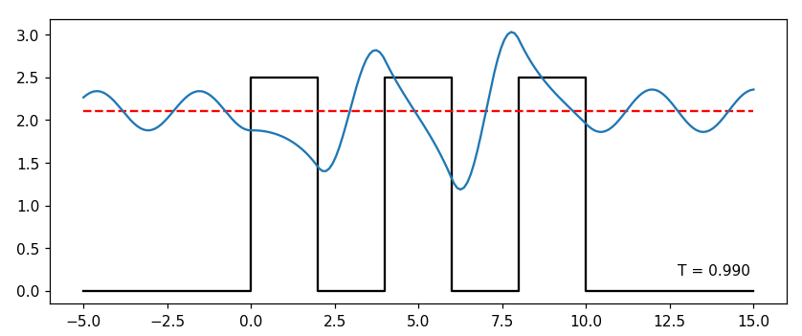
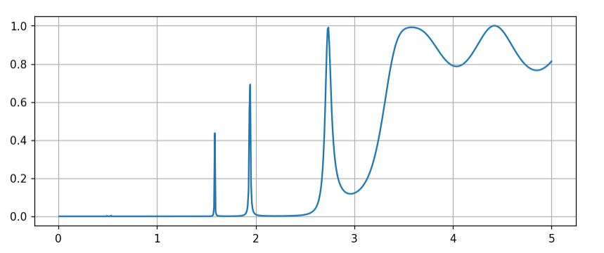
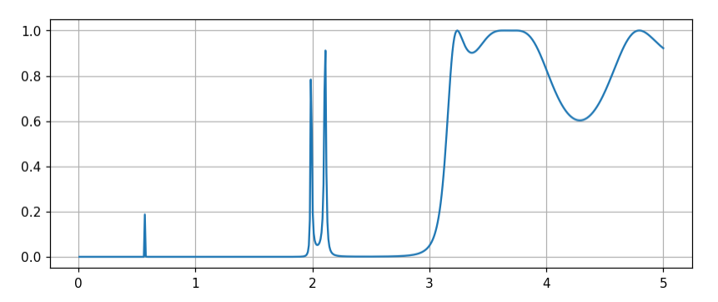
3.a) + 3.b) Comparing double and single well
For 3 energy barriers of equal height, the peaks are more localized (for 3 equally high barriers)
The decreasing the height of the mid-bar separates the transmission peaks
E=1.99
E=2.11

Slide 14
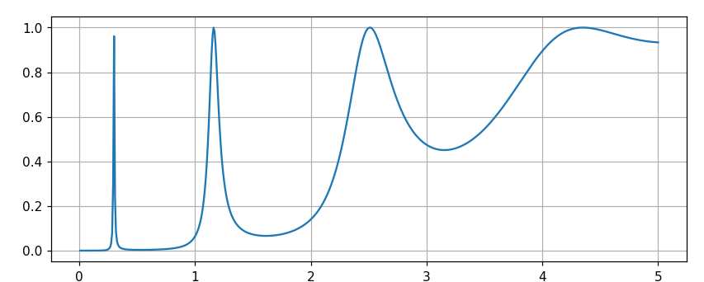
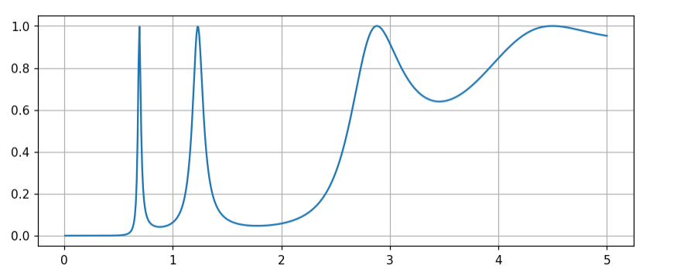
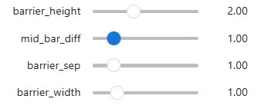
3.c) Lowering middle barrier
Single well (no middle bar):
Double well:

Slide 15
4

Slide 16
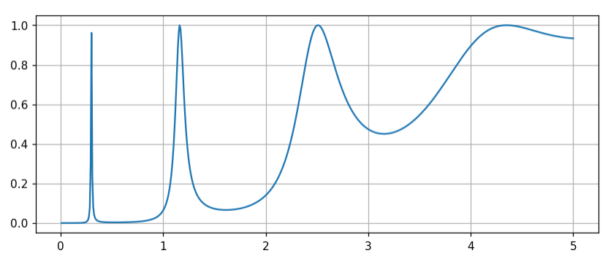
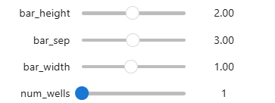
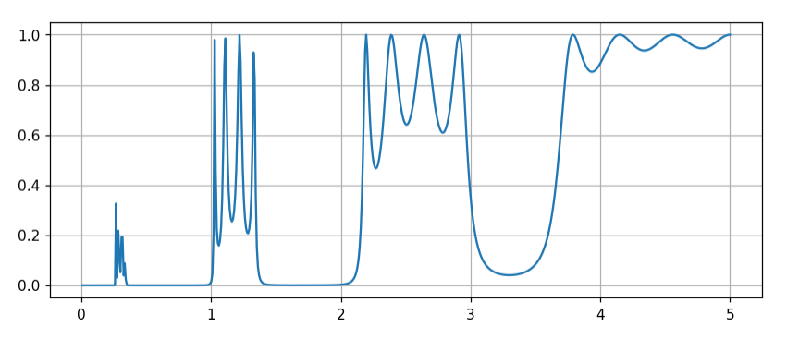
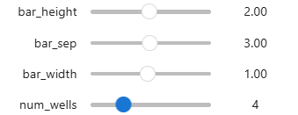
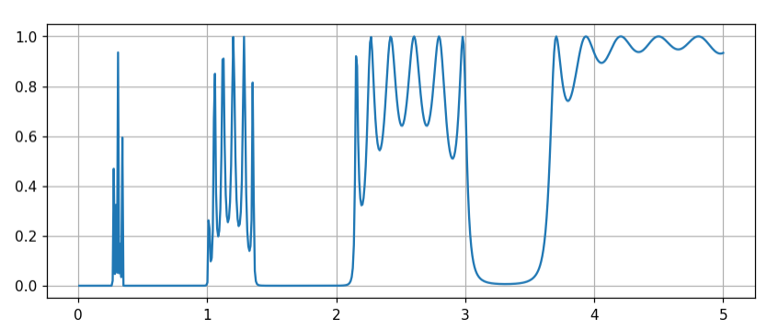
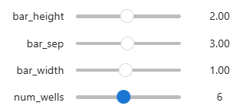
4.a) Peaks vs number of wells
Number of wells: 1:1 additional “sub”-peaks in each “region” (corresponding to the peaks of the single well).
Localized in the same energy bandwidth (see region for which the “cluster” of peaks emerge)

Slide 17
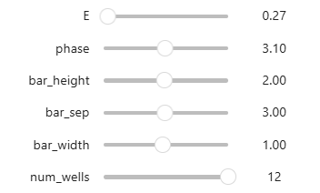
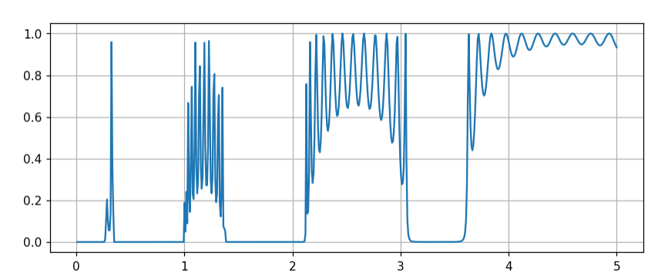
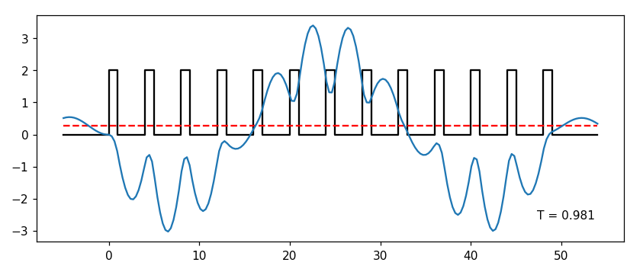
4.b) Lowest peaks for higher number of wells
There is a wave-packet periodicity

Slide 18
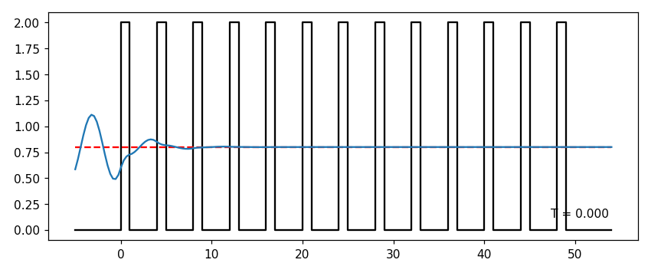
4.c) Wave function inside energy “gap”
Behaves like a single barrier of high width.

